Slide 1
2.Searching and Sorting
The process of finding a particular record in a list is called “Searching”.
Searching is an operation which finds the place of a given element in the list.
20 30 40 50 (these nos are stored in array)
0 1 2 3 4 array location
Search is said to be successful or unsuccessful depending upon whether the element that is being searched is found or not.

Slide 2
2 types of Searching
1.Linear search/Sequential Search
2.Binary search
1.Linear/Sequential Search:-
It is the simplest method for searching.
The element to be found is searched sequentially in the list.
It can be used on a sorted or an unsorted list.

Slide 3
Procedure of linear search
Step 1: Read the search element from the user
Step 2: Compare, the search element with the first element in the list.
Step 3: If both are matching, then display "Given element found!!!" and terminate the function

Slide 4
Procedure of linear search
Step 4: If both are not matching, then compare search element with the next element in the list.
Step 5: Repeat steps 3 and 4 until the search element is compared with the last element in the list.
Step 6: If the last element in the list is also doesn't match, then display "Element not found!!!" and terminate the function.

Slide 5
Procedure of linear search
1.Initalize search key element. i.e. the element to be searched in the list.
2.Compare key element with 0th portion element. If match is found then search is successful.
3.If match is not found then key element is compared with the next element.
4.Repeat the procedure till (n-1)th comparison

Slide 6
5.After (n-1)th comparison ,if match is not found then search is unsuccessful.

Slide 7
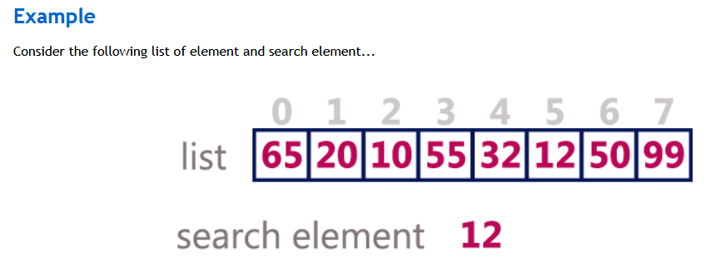
Example of Linear Search

Slide 8
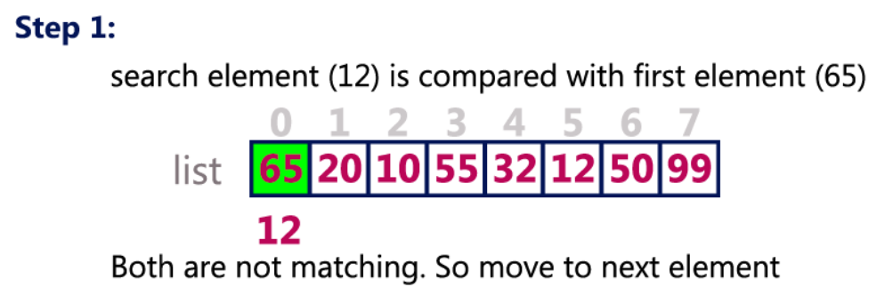

Slide 9
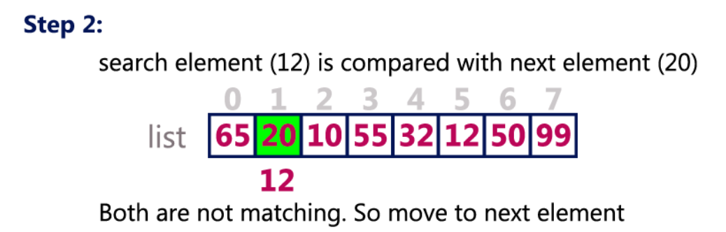

Slide 10
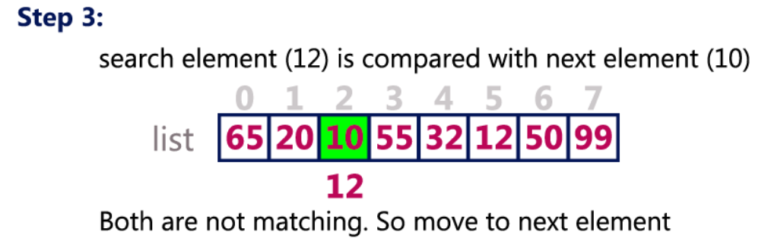

Slide 11
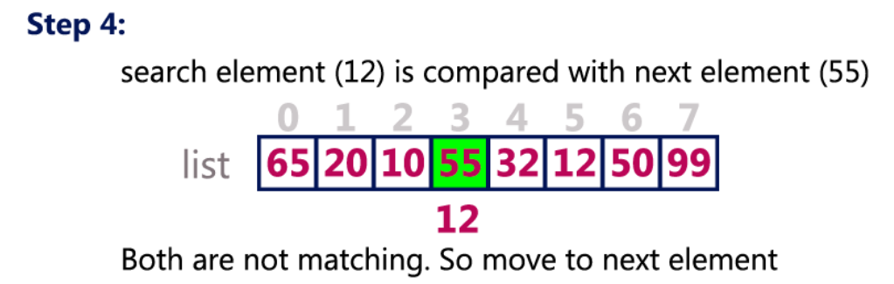

Slide 12
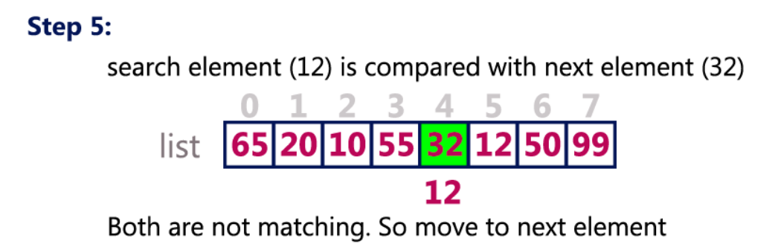

Slide 13
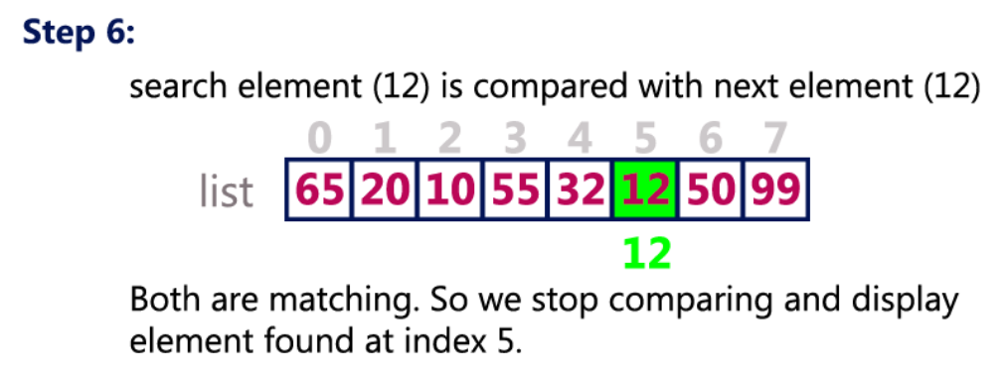

Slide 14
Advantages of Linear search
1.It is a simple method and easy to implement
2.It does not require the data to be ordered.
3.It does not require any additional data.

Slide 15
Disadvantages of Linear search
1.If the size of the array is large then it consumes time.
2.It needs more space and time
3.In the worst case ,if n is very large ,this method is very inefficient and slow.

Slide 16
Time complexity of Linear Search
Best Case:- Record/element found at position 1
Then number of comparisons =1
Worst case:- Record /element not present(or at the end of the list)
So number of comparisions = n+1
Average case:- n+1 comparisons are required to retrieve record 2

Slide 17
Time complexity of Linear Search of the order n(array size) i.e O(n)

Slide 18
Algorithm for Linear Search
Step1: start
Step2: Read /accept a values from user
Step3:- Repeat for i=0 to N – 1
If A[i]=item then
Write “item found at location”
Exit
End if
end of for loop
Step4:- Write “Item not found”
Step5:-Stop

Slide 19
Program for linear search
void main()
{
int a[10],i=0,n,search;
clrscr();
printf("\n Enter the size of array:");
scanf("%d",&n);
printf("\nEnter array numbers:\n");
for(i=0;i<=n-1;i++)
{
scanf("%d",&a[i]);
}

Slide 20
printf("\nEnter the number to search:");
scanf("%d",&search);
for(i=0;i<=n-1;i++)
{
if(a[i]==search)
{
printf("%d is present at location %d:\n", search, i);
break;
}
}

Slide 21
if (i==n)
{
printf("%d is not present in array", search);
}
getch();
}

Slide 22
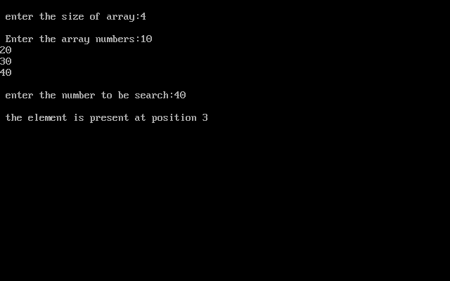

Slide 23
Binary Search
Binary search is a fast search algorithm that works efficiently with a sorted list.
In this method we make a comparison between key and the middle element of the array.
As array is already sorted ,this comparison results either in a match between key and the middle element of array.

Slide 24
Binary Search
If key element not matches with the middle position element then the same procedure is repeated on the left half or right half in which the key element(searching number) is to be present.

Slide 25
This search algorithm works on the principle of divide and conquer. For this algorithm to work properly, the data collection should be in the sorted form.
Binary search is a fast search algorithm with run-time complexity of Ο(log2 n).

Slide 26
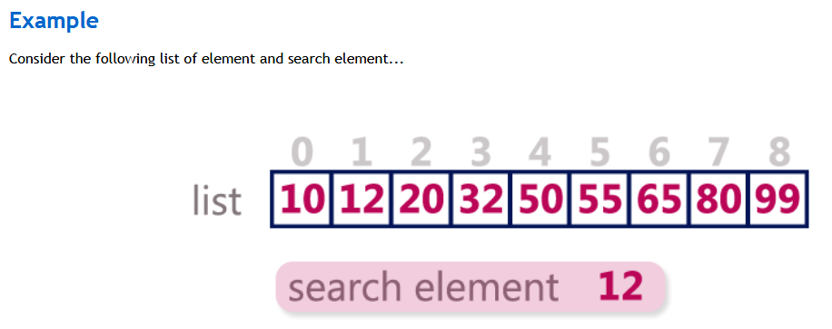
Example of Binary Search

Slide 27
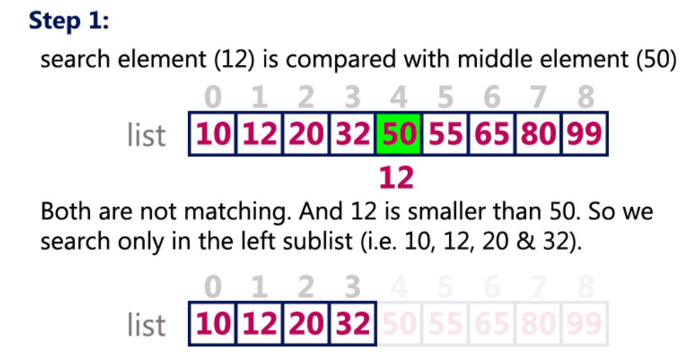

Slide 28
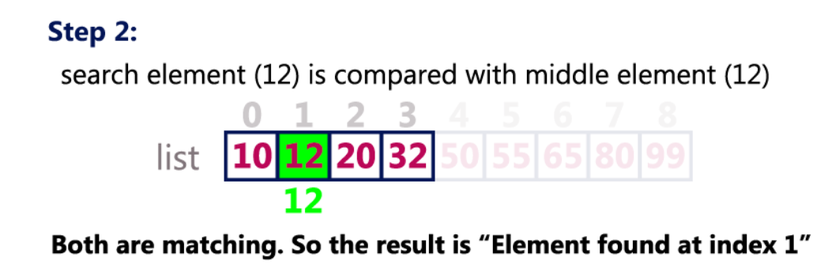

Slide 29

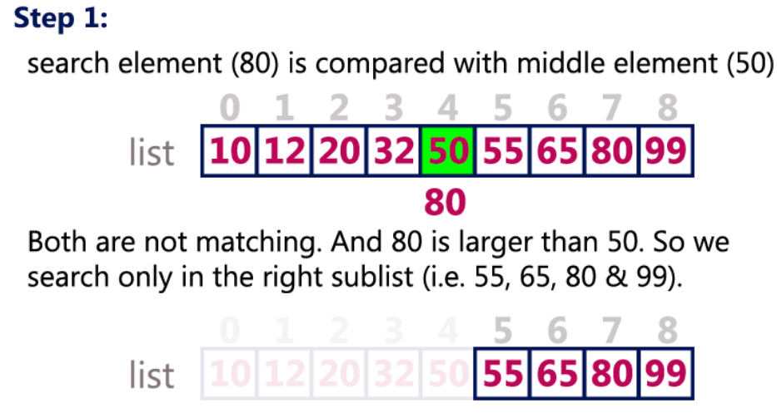

Slide 30
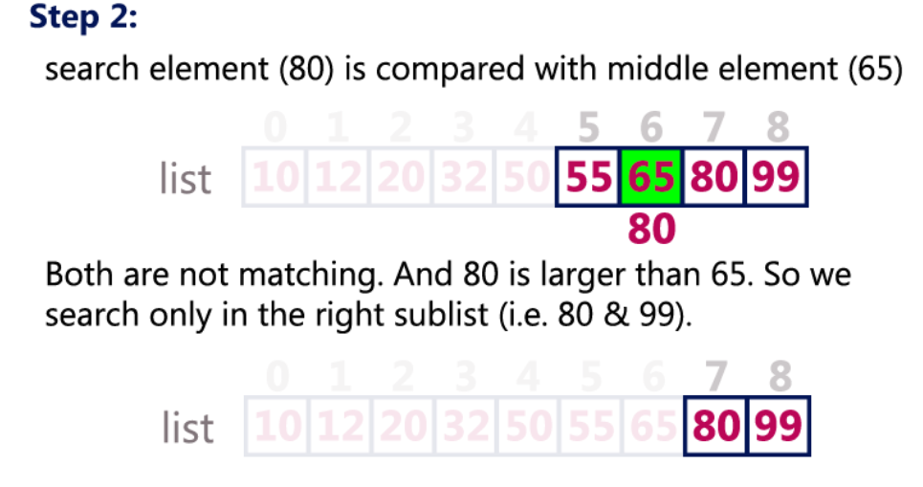

Slide 31
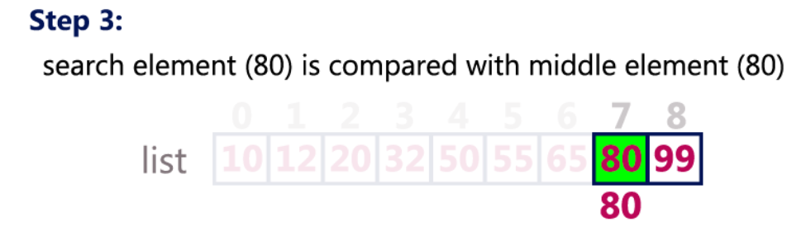


Slide 32
Steps in Binary Search
Step 1: Read the search element from the user
Step 2: Find the middle element in the sorted list
Step 3: Compare, the search element with the middle element in the sorted list.
Step 4: If both are matching, then display "Given element found!!!" and terminate the function

Slide 33
Step 5: If both are not matching, then check whether the search element is smaller or greater than middle element.
Step 6: If the search element is smaller than middle element, then repeat steps 2, 3, 4 and 5 for the left sub list of the middle element.

Slide 34
Step 7: If the search element is larger than middle element, then repeat steps 2, 3, 4 and 5 for the right sub list of the middle element.
Step 8: Repeat the same process until we find the search element in the list or until sub list contains only one element.
Step 9: If that element also doesn't match with the search element, then display "Element not found in the list!!!" and terminate the function.

Slide 35
Algorithm for Binary Search
Step1:Start
Step2: Initialize the variables beg,end,mid,position;
Step 3:- Repeat step 4 and 5 while beg<=end
Step 4: find the mid= (beg + end)/2
Step 5: if A[mid]== val then
position=mid
print position
Go to step 7
if A[mid]>Val then
set beg=mid - 1

Slide 36
else
Set beg=mid+1
End of if
End of loop
Step 6: if position=-1 then
print “value is not present in the array”
End of if
Step 7: exit

Slide 37
Advantages of Binary Search
1. If the array size is large then binary search is very much faster than linear search.
2.It is more efficient

Slide 38
Disadvantages of Binary Search
1.Data has to be in sorted order
2.This method can only be applied to linear and sequential data structure

Slide 39
Complexity of Binary Search
During each iteration the value of mid is calculated as mid= (beg+end)/2
For binary search maximum number of comparisons for successful and unsuccessful search is given by
O(log₂ n)

Slide 40
Program for binary search
void main()
{
int a[10],n,i,item,beg,end,mid,flag=0;
//n = number of elements for array
clrscr();
printf("\n Enter size of array :");
scanf("%d",&n);
for(i=0;i<=n-1;i++)
{
scanf("%d",&a[i]);
}
printf("\n Enter element to be searched:");
scanf("%d",&item);

Slide 41
beg=0, end=n-1;
while(beg<=end)
{
mid=(beg+end)/2;
if(item==a[mid])
{
flag=1;
break;
}

Slide 42
else if(item<a[mid])
end=mid-1;
else
beg=mid+1;
}
if(flag==1)
printf("\n Item %d present at position %d",item,mid);
else
printf("\n not present");
getch();
}

Slide 43
Difference between linear and binary search
Linear Search
1. Data can be in any order.
2. Multidimensional array also can be used.
3.TimeComplexity:- O( n)
4. Not an efficient method to be used if there is a large list.
Binary Search
Data should be in a sorted order.
Only single dimensional array is used.
Time Complexity:- O(log2 n)
Efficient for large inputs also.

Slide 44

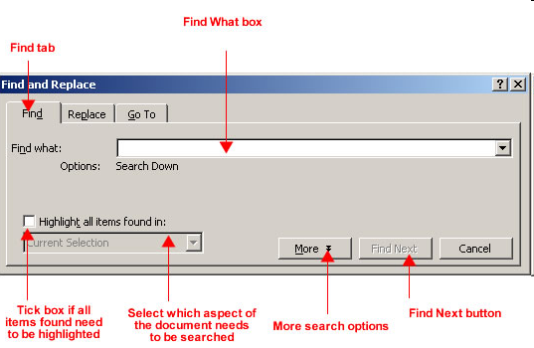
Application of Searching

Slide 45
SORTING
Sorting means arranging the elements of an array either in ascending or descending order.
Each sorting algorithm may be analyzed on amount of time necessary for running the program and amount of space required for the program.
The amount of time is proportional to the number of key comparisons.

Slide 46
Types of Sorting
1.Bubble sort
2.Selection sort
3.Insertion sort
4.Quick sort
5.Radix sort

Slide 47
1.Bubble sort
Bubble sort is very simple method.
This method begins with the 0th element.
The 0th element is compared with the 1st element
If 0th element is found to be greater than the 1st element then they are interchanged otherwise not interchanged.

Slide 48
Bubble sort
In this way all the elements are compared with their next element and are interchanged if required.
The output of first iteration is the largest element gets placed at the last position
Similarly in the second iteration, second largest element gets placed at the second last position

Slide 49
Bubble sort
As a result after (n-1) th iteration ,the list becomes a sorted list.

Slide 50
Procedure of Bubble sort
1.In the first iteration 0th element is compared with the 1st element ,if 0th element is greater then they are interchanged.
2.1st element is compared with the 2nd element if 1st element is greater then they are interchanged else not.
3.Repeat the procedure until (n-2)th is compared with (n-1)th element.

Slide 51
Advantages of Bubble Sort
1.It is simple to write and easy to understand.
2.It only takes a few lines of code
3.The data is sorted in place so there is little memory overhead
4.Once sorted ,the data is in memory and ready for processing

Slide 52
Disadvantages of Bubble Sort
1.The major disadvantage is the amount of time it takes to sort
2.The average time increases almost exponentially as the number of table elements increase.

Slide 53
Complexity of Bubble Sort
If there are ‘n’ number of elements in an array then (n-1)th comparisons are required.
The worst case arises when the given array is sorted in reverse order.
In this case all the iterations required will be :
(n-1) + (n-2) +……+2+1=n(n-1)/2

Slide 54
Complexity of Bubble Sort
Worst Case Complexity= O(n²)
Average case Complexity= O(n²)
Best case Complexity= O(n²)

Slide 55
Algorithm for Bubble Sort
Step1: Accept N number //accept the array size
Step2:- Repeat step 3 for i= 0 to N-1 by 1
Step3:-Repeat for j=0 to N-i by 1
if A[j] > A[j+1],then
set temp=A[j]
A[j]=A[j+1]
A[j+1]=temp
End of if
End of step 3 loop
End of step 2 loop

Slide 56
Algorithm for Bubble Sort
Step4:Write sorted array :A
Step5:Stop

Slide 57
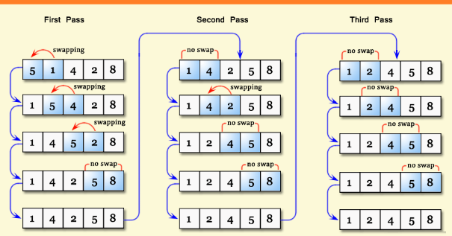
Bubble Sort example

Slide 58
Program for Bubble Sort
void main()
{
void main()
{
int a[100];
int i,j,temp,n;
clrscr();
printf("\n Enter the array size:\n");
scanf("%d",&n);
printf("Enter array numbers you want to sort:\n");
for (i=0;i<=n-1;i++)
{
scanf("%d",&a[i]);
}

Slide 59
for(i=0;i<=n-1;i++)
{
for(j=0;j<=n-1;j++)
{
if(a[j]>a[j+1])
{
temp=a[j];
a[j]=a[j+1];
a[j+1]=temp;
}
}
}

Slide 60
printf("\n Array after sorting:\n");
for(i=0;i<=n-1;i++)
printf("%d\t",a[i]);
getch();
}

Slide 61
2.Selection sort
The selection sort is the easiest method of sorting.
The 0th element is compared with all other elements
If 0th element is found to be greater then interchange the number otherwise not.
Repeat this procedure until the entire array is sorted
.

Slide 62
Procedure for Selection Sort
1. In the first iteration ,0th element is compared with the 1st element ,if 0th element is greater then 1st element they are interchanged.
2. If 0th element is not greater than 1st element then they are not interchanged.
3.The process is repeated till the 0th element is compared with the rest of the elements.
4.At the end of first iteration 0th element holds the smallest number.

Slide 63
Procedure for Selection Sort
5) The second iteration starts with the 1st element
6) The process of comparison and swapping is repeated.
7) After (n-1)th iteration ,the array is sorted.

Slide 64
Example of selection sort
0 | 1 | 2 | 3 | 4 | 5
25 | 15 | 4 | 103 | 62 | 9
Iteration 1
25 | 15 | 4 | 103 | 62 | 9
0th element is compared with 1st element ,if 0th element is greater then interchange
15 | 25 | 4 | 103 | 62 | 9

Slide 65
Program for selection sort
void main()
{
int a[100],n,i,j,temp;
clrscr();
printf("\n Enter the Number of Elements: ");
scanf("%d",&n);
printf("\n Enter %d Elements: ",n);
for(i=0;i<n;i++)
{
scanf("%d",&a[i]);
}

Slide 66
for(i=0;i<=n-1;i++)
{
for(j=i+1;j<=n-1;j++)
{
if(a[i]>a[j])
{
temp=a[i];
a[i]=a[j];
a[j]=temp;
}
}
}

Slide 67
printf("\n Array after sorting:\n");
for(i=0;i<=n-1;i++)
printf("%d\t",a[i]);
getch();
}

Slide 68
Advantages ,Disadvantages of Selection sort
1.It is simple and easy to implement
2.It can be used for small data sets.
Disadvantages:-
In case of larger data sets ,the efficiency of selection sort drops.

Slide 69
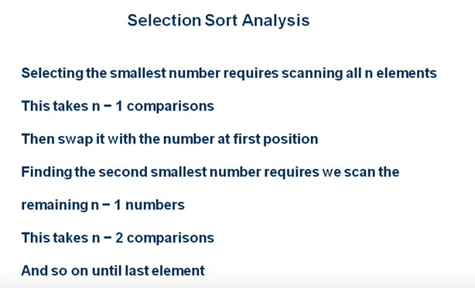

Slide 70
Complexity of Selection Sort
Therefore (n-1) + (n-2) +…………….+2+1
= n(n-1)
2
=O(n²) comparisons.
Worst Case : O(n²)
Average Case: O(n²)
Best Case: O(n²)

Slide 71
Example of Insertion Sort
Arrangement of cards by card player.
Card player pick up the cards and inserts them into them into the required position

Slide 72
Insertion Sort
Insertion sort inserts each item into its proper place in the final list.
Insertion sort algorithm sorts a list of values by respectively inserting a particular value into a subset of the list that has already been sorted.
Sort the first two values in the list relative to each other by exchanging them if necessary.

Slide 73
Insertion Sort
Insert the lists third value into the appropriate position relative to the first two sorted values.
Then insert the fourth value into its proper position relative to the first three values in the list.
Continue this process for each position in the list.

Slide 74
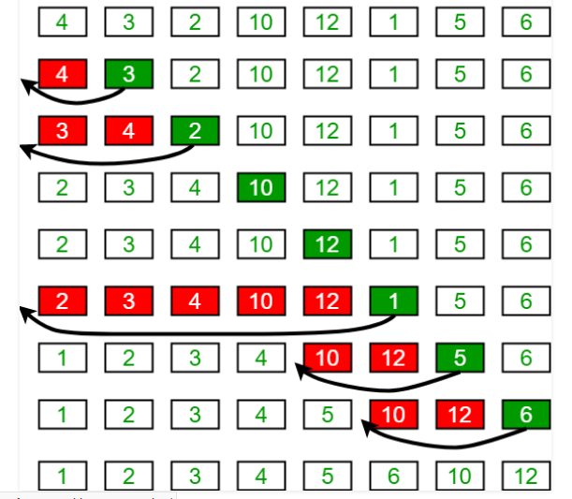
Insertion Sort Example

Slide 75
Procedure for Insertion Sort
1.Consider the first item to be a sorted sublist(only 1 item in the list).
2.Insert the second item into the sorted sublist.
3.All necessary shifting of items is done to make room to insert new addition.

Slide 76
Radix Sort
Radix sort is based on the position of digits.
The number is represented with different positions.
The number has units ,tens,hundres positions onwards.
Based on its position the sorting is done.

Slide 77
Procedure for Radix sort
1.In the first iteration ,the elements are picked up and kept in various pockets by checking their unit digit.
2.In second iteration ,the ten digits are sorted.
3.In third iteration ,the digits at hundreds position are sorted.
4.Repeat the procedure until we will set a sorted array.

Slide 78
Advantages of Radix sort
1.Radix sort is a very simple algorithm
2.Radix sort is one of the fastest sorting algorithm for numbers

Slide 79
DisAdvantages of Radix sort
1.Radix sort takes more space than other sorting algorithms.
2.Radix sort is dependent on the digits
3.For every different data type ,the algorithm has to be rewritten.
4.Radix sort takes more time to write

Slide 80
Quick Sort
Quick sort algorithm uses the idea of divide and conquer strategy .
It finds the element called pivot element which divides the array into two parts in such a way that element in the left side are smaller than pivot element and elements in the right side are greater than pivot element.

Slide 81
Advantages of Quick Sort
1.It is faster than other algorithms such as bubble sort, selection sort and insertion sort.
2.Quick sort can be used to sort arrays of small size ,medium size or large size.

Slide 82
Disadvantages of Quick Sort
Quick sort is complex.
Complexity of Quick Sort:
Best case:- O(n log n)
Worst Case:- O(n2)

